Slide 1
CenterPoint Energy
Bloomington – Penn Avenue 2021 Belt Line Project
February 2021

Slide 2
CenterPoint Energy - Minnesota Gas Operations
Minnesota Based
Founded in 1870
870,000+ customers
Serving 260+ communities
1,200 employees
Invested $1+ billion in infrastructure since 2013, with plans to invest additional $1 billion in next 5 years
14,000 miles of gas pipeline

Slide 3
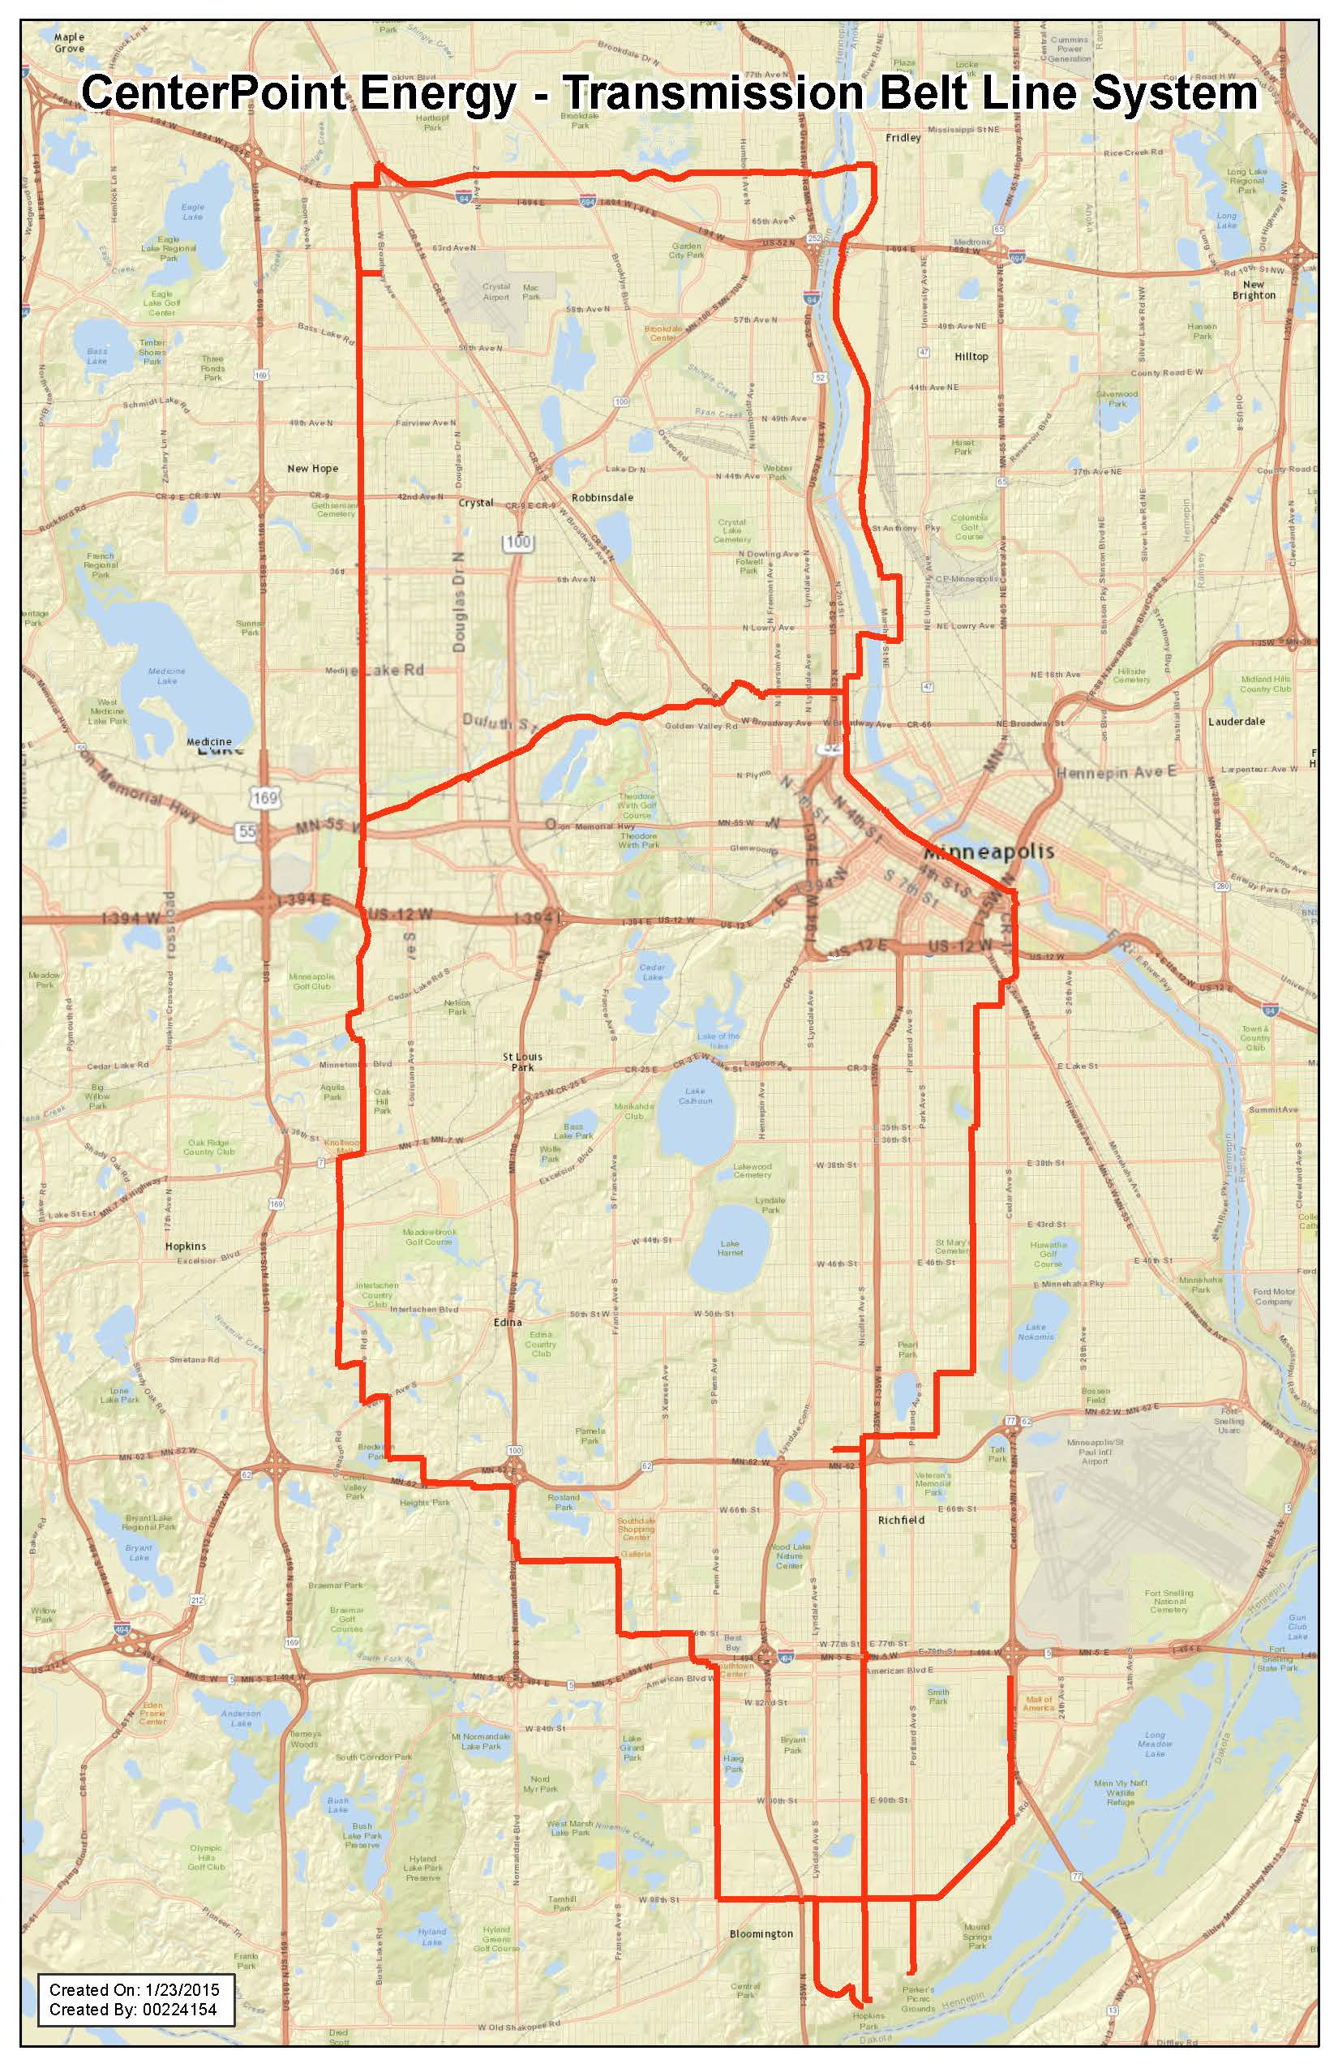
Minnesota Belt Line
Approximately 74-mile system of 20- and 24-inch diameter steel pipe. Multi-year project to upgrade and rehabilitate approximately 61 miles of the system.
This project will enhance long-term safety, reliability, and better facilitate ongoing inspection of pipeline.
Construction activity in 2021 will include Bloomington, Brooklyn Park, Burnsville, and Edina.

Slide 4
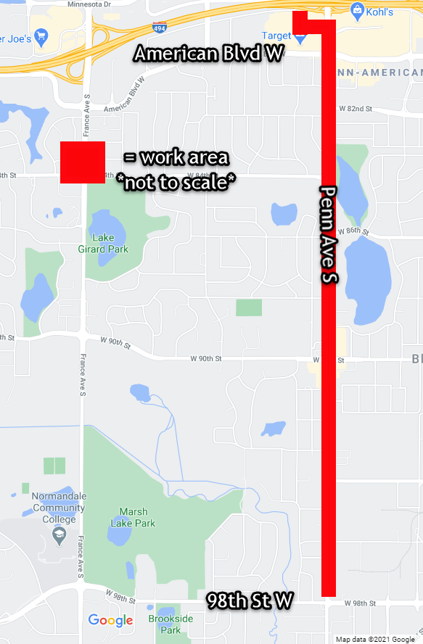
Bloomington – Penn Avenue 2021 Belt Line Project
Phase 1: Michels Corporation will replace the first of the project’s two natural gas mains. This main will feed the natural gas service lines to homes and businesses.
Phase 2: Michels Corporation will connect the service lines to the new Phase 1 gas main.
Phase 3: CenterPoint Energy’s authorized contractor will replace the second gas main, shown in red.
Phase 4: Q3 Contracting will restore the areas affected by work on the natural gas lines. Some of the restoration will happen during Phases 1 through 3.

Slide 5
Traffic Impacts
For Phase 1, lane closures may occur. Once final traffic plans are available, the access routes will be updated on our construction website.
For Phase 3, the crews will work on Penn Ave. a few blocks at a time. Restoration of the road will follow closely behind the pipe installation crew. Detours will direct drivers. Residential traffic will be maintained.
The crews will be on site, assisting residents with access during construction. They will notify customers once they are going to be working in front of their home.

Slide 6
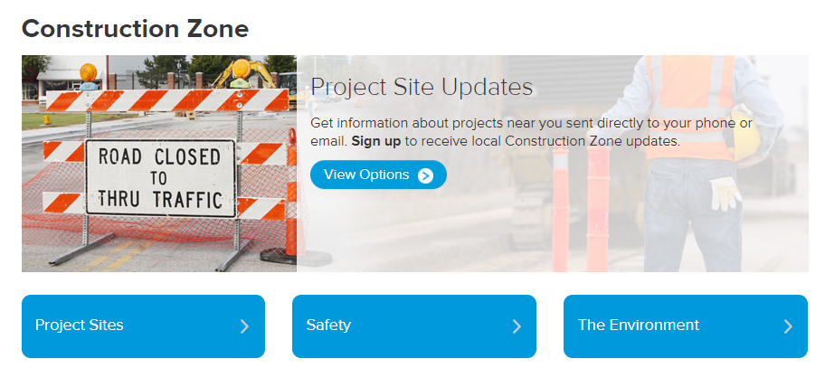
How can I get construction updates?
Go to our Construction Zone website at www.centerpointenergy.com/construction.
Click on “Project Sites” and select the project’s name.
On the project’s page, check out our Project Updates link.
Click our Sign Up for Status Updates for email or text message updates.
For text-to-subscribe updates, text CNP PENN2021 to GOV311 (468311).

Slide 7
Contact Information for Construction Questions
Website:
CenterPointEnergy.com/ Construction
Construction questions:
hannah.gullickson@ centerpointenergy.com
612-321-5546
Restoration questions:
csv.restoration@
centerpointenergy.com
612-321-5477
All other questions:
csv.constructionservices@centerpointenergy.com
612-321-5369

Slide 8
Road, Sidewalk and Grassy Area Restoration
After construction, restoration will be done to:
Streets
Sidewalks
Boulevards
Lawns
Areas disturbed by CenterPoint Energy’s construction will be restored to original condition.

Slide 9
In Closing
Thank you for your patience while construction is taking place. Replacing aging infrastructure is an important but difficult task.
This work is part of CenterPoint Energy’s ongoing commitment to ensure the safe and reliable delivery of natural gas now and into the future.
➢ Please continue to patronize local area businesses. They will be open and accessible during construction.

